Slide 1



Presentation IX
Inverse-Adding Doubling Method
Thu Ta Zaw
2415121095

Slide 2

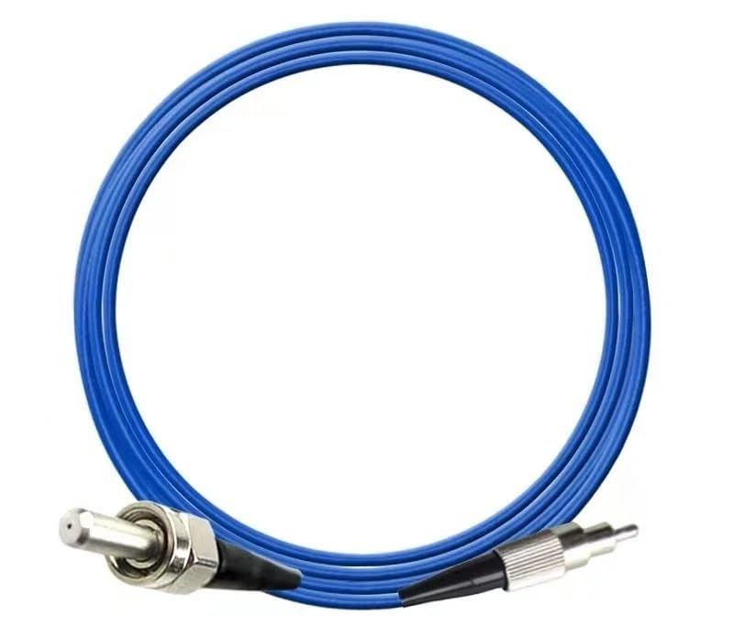
SMA-SMA Connector
Recommended Specification
Connection type: (SMA 905 – SMA 905)
Transmission wavelength range: Compatible with 850 nm
Fiber type: Multimode fiber
Core diameter: Recommend >= 400 micrometer (diameter)
Numerical aperture (NA) >= 0.2 mm
Product
Brand: JTSF
Name: Fiber Optic Patch Cord (SMA 905 - SMA 905) VIS-IR NA 0.22 400 um, FSMA905 FC ST Energy Fiber 1m, 2M 300 Cm 5M (SMA-SMA blue 1m)
Fig. SMA905-SMA905 cable

Slide 3
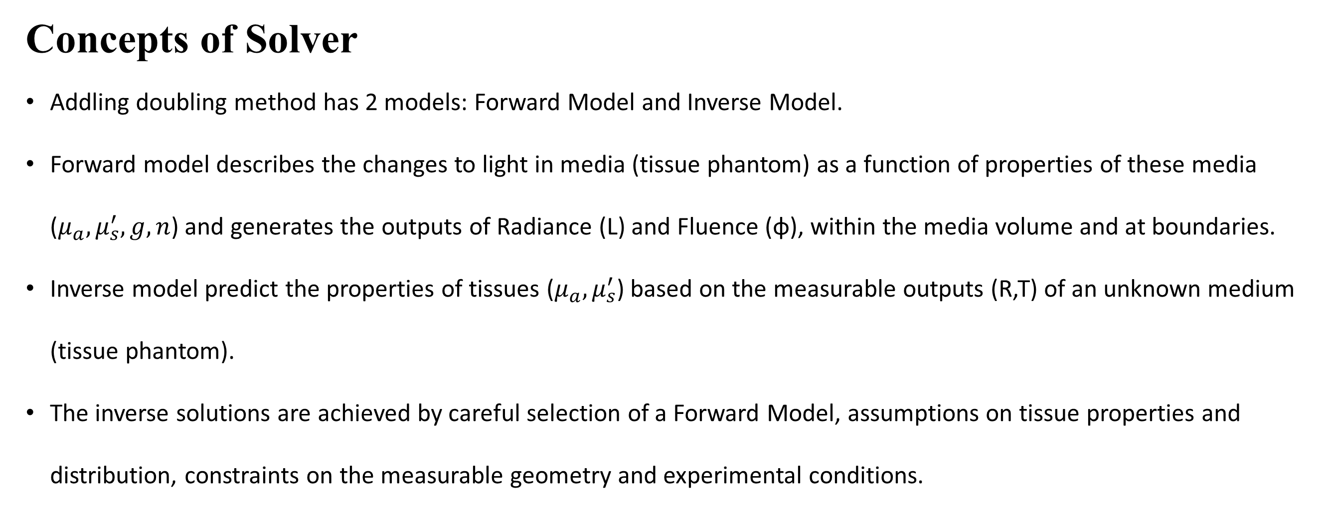
Computational Method
Concepts of Solver
Addling doubling method has 2 models: Forward Model and Inverse Model.
Forward model describes the changes to light in media (tissue phantom) as a function of properties of these media ($μ_{a},μ_{s}^{′},g,n$) and generates the outputs of Radiance (L) and Fluence ($\text{φ}$), within the media volume and at boundaries.
Inverse model predict the properties of tissues ($μ_{a},μ_{s}^{′}$) based on the measurable outputs (R,T) of an unknown medium (tissue phantom).
The inverse solutions are achieved by careful selection of a Forward Model, assumptions on tissue properties and distribution, constraints on the measurable geometry and experimental conditions.

Slide 4
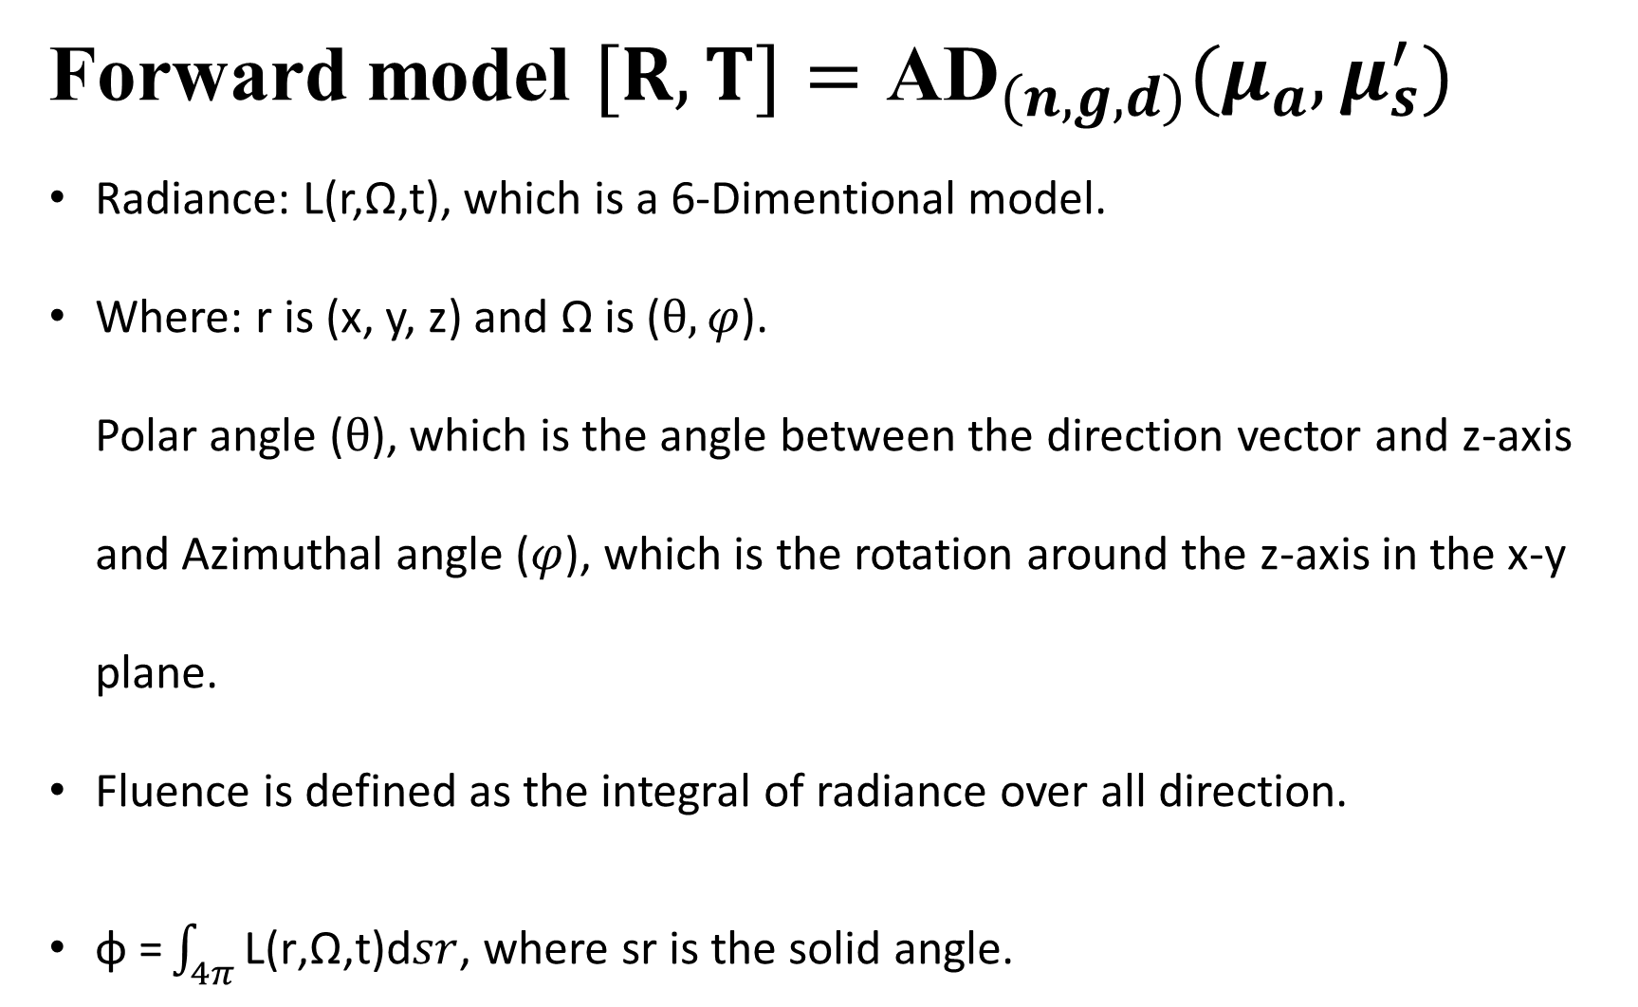
Adding-Doubling Method
Forward model $[R,T]={\text{AD}}_{\left(n,g,d\right)}(μ_{a},μ_{s}^{′})$
Radiance: L(r,Ω,t), which is a 6-Dimentional model.
Where: r is (x, y, z) and Ω is ($θ,φ$). Polar angle ($θ$), which is the angle between the direction vector and z-axis and Azimuthal angle ($φ$), which is the rotation around the z-axis in the x-y plane.
Fluence is defined as the integral of radiance over all direction.
$\text{φ}\text{ =}\int_{4π}{\text{L}\text{(}\text{r}\text{,}\text{Ω}\text{,}\text{t}\text{)}\text{d}sr}$, where sr is the solid angle.
Fig. reflectance and transmittance

Slide 5
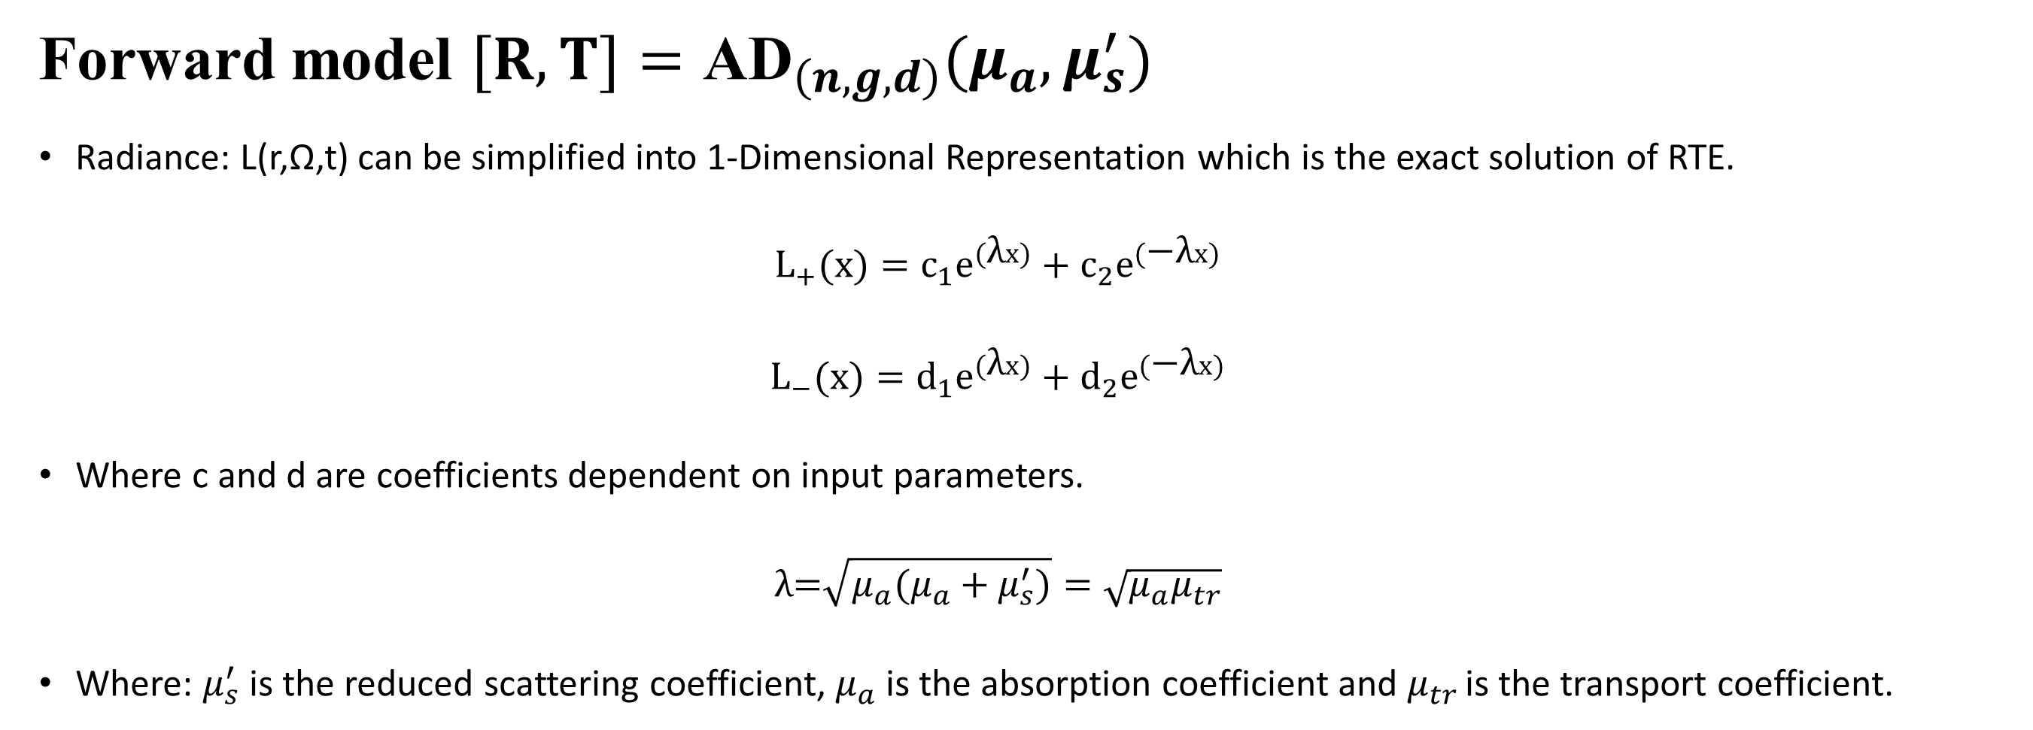
Adding-Doubling Method
Forward model $[R,T]={\text{AD}}_{\left(n,g,d\right)}(μ_{a},μ_{s}^{′})$
Radiance: L(r,Ω,t) can be simplified into 1-Dimensional Representation which is the exact solution of RTE.
$$L_{+}(x)=c_{1}e^{(\text{λ}x)}+c_{2}e^{(\text{−}\text{λ}x)}$$
$$L_{−}(x)=d_{1}e^{(\text{λ}x)}+d_{2}e^{(\text{−}\text{λ}x)}$$
Where c and d are coefficients dependent on input parameters.
$$\text{λ}\text{=}\sqrt{μ_{a}(μ_{a}+μ_{s}^{′})}=\sqrt{μ_{a}μ_{tr}}$$
Where: $μ_{s}^{′}$ is the reduced scattering coefficient, $μ_{a}$ is the absorption coefficient and $μ_{tr }$is the transport coefficient.

Slide 6
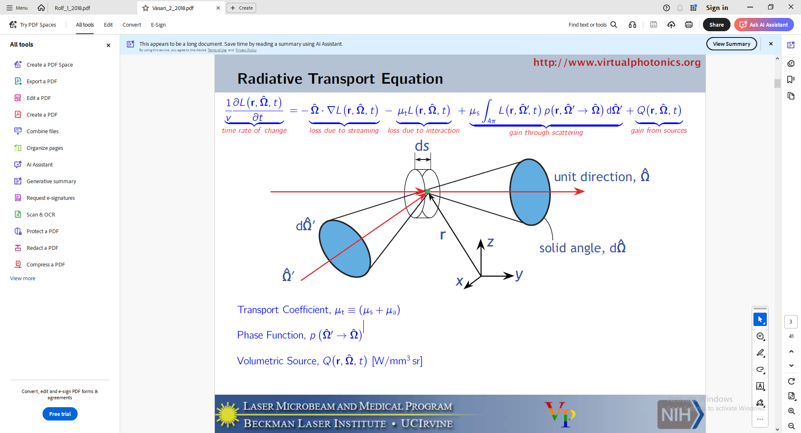
Reducing Dimensionality
Radiative Transport Equation

Slide 7

Reducing Dimensionality
Radiative Transport Equation
$$\frac{1}{v}\frac{∂\text{L}\text{(}\text{r}\text{,}\hat{\text{Ω}}\text{,}\text{t}\text{) }}{∂t}=−\hat{\text{Ω}}.∇\text{L}\text{(}\text{r}\text{,}\hat{\text{Ω}}\text{,}\text{t}\text{)}−μ_{t}\text{L}\text{(}\text{r}\text{,}\hat{\text{Ω}}\text{,}\text{t}\text{)}+μ_{s}\int_{4π}{\text{L}\text{(}\text{r}\text{,}\hat{\text{Ω}}\text{,}\text{t}\text{)}\text{p}\text{(}\text{r}\text{,}{\hat{\text{Ω}}}^{′}→ \hat{\text{Ω}}\text{)}d{\hat{\text{Ω}}}^{′}+\text{Q}\text{(}\text{r}\text{,}\hat{\text{Ω}}\text{,}\text{t}\text{)}}$$
Steady-state: eliminate all time dependence.
$$\hat{\text{Ω}} .∇\text{L}\text{(}\text{r}\text{,}\hat{\text{Ω}}\text{)}=−μ_{t}\text{L}\text{(}\text{r}\text{,}\hat{\text{Ω}}\text{)}+μ_{s}\int_{4π}{\text{L}\text{(}\text{r}\text{,}\hat{\text{Ω}}\text{)}\text{p}\text{(}\text{r}\text{,}{\hat{\text{Ω}}}^{′}→ \hat{\text{Ω}}\text{)}d{\hat{\text{Ω}}}^{′}+\text{Q}\text{(}\text{r}\text{,}\hat{\text{Ω}}\text{)}}$$
Reduce spatial components to 1-D.
$$\hat{\text{Ω}} .\frac{∂\text{L}\text{(}\text{x}\text{,}\hat{\text{Ω}}\text{) }}{∂x}=−μ_{t}\text{L}\text{(}\text{x}\text{,}\hat{\text{Ω}}\text{)}+μ_{s}\int_{4π}{\text{L}\text{(}\text{x}\text{,}\hat{\text{Ω}}\text{)}\text{p}\text{(}\text{x}\text{,}{\hat{\text{Ω}}}^{′}→ \hat{\text{Ω}}\text{)}d{\hat{\text{Ω}}}^{′}+\text{Q}\text{(}\text{x}\text{,}\hat{\text{Ω}}\text{)}}$$
Integrate over all angles to get coupled equations for forward and back scattered radiances.
$$α_{1}\frac{∂L_{+}(x)}{∂x}=−μ_{t}L_{+}\left(x\right)+μ_{s}\left(α_{2}L_{+}\left(x\right)−α_{3}L_{−}\left(x\right)\right)+\text{Q}\text{(}\text{x}\text{)}$$
$$β_{1}\frac{∂L_{−}(x)}{∂x}=−μ_{t}L_{−}\left(x\right)+μ_{s}\left(β_{2}L_{+}\left(x\right)−β_{3}L_{−}\left(x\right)\right)+\text{Q}\text{(}\text{x}\text{)}$$

Slide 8

Reducing Dimensionality
Boundary condition
Adding-Doubling method calculates to Reflectance and Transmittance for slabs.
$$L^{1+}=T^{01}L^{0+}+R^{10}L^{1−}$$
$$L^{0−}=R^{01}L^{0+}+T^{10}L^{1−}$$
From these equations, we can calculate T and R.
$L^{1−}$= 0 if we only have single light source.
Fig. Boundary condition and direction of light

Slide 9
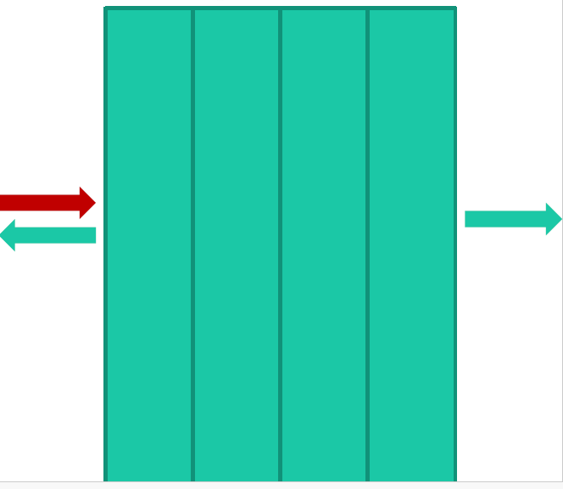
Reducing Dimensionality
Doubling
Calculate the Reflectance and Transmittance of light from a single thin, homogeneous layer by sub dividing into multiple thin equal slab.
Reflectance and transmittance from an arbitrarily thick slab can then be obtained by repeatedly doubling the thin slab solution until the desired thickness is achieved.
Fig. Doubling (separation big slab into multiple small slabs)

Slide 10
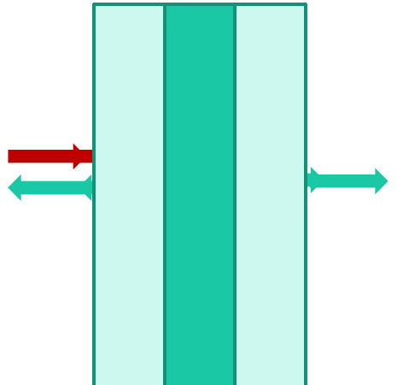
Reducing Dimensionality
Adding
An extension of doubling permitting layers of differing optical properties and be added in order to calculate Reflectance and Transmittance in more complex structures including international reflection at layer boundary.
Adding doubling method can be used for any optical wavelength.
There is no restriction of the radio of scattering to absorption.
Fig. Thin slab sandwitch between two different material

Slide 11
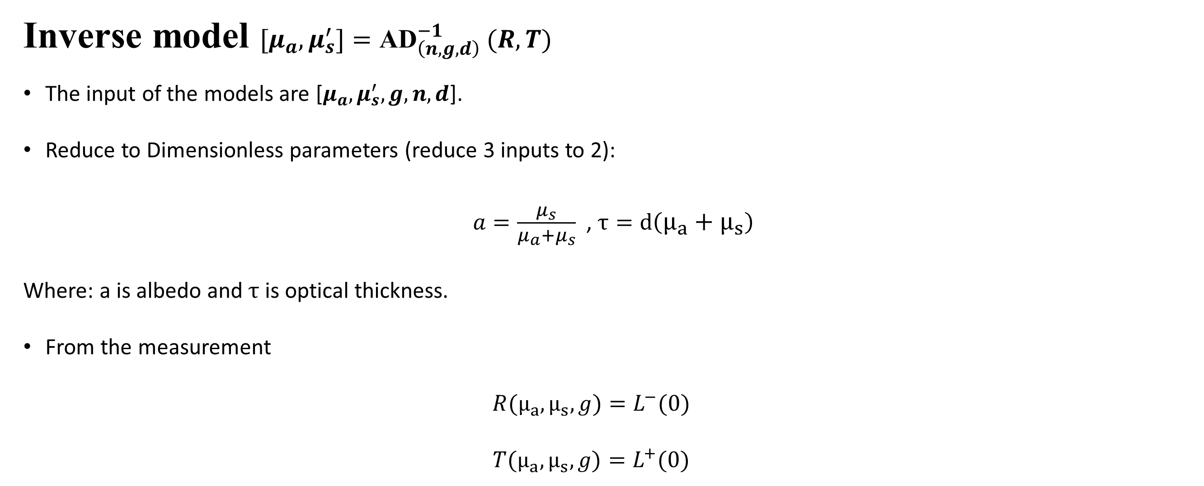
Inverse Adding-Doubling Method
Inverse model $[μ_{a},μ_{s}^{′}]={\text{AD}}_{\left(n,g,d\right)}^{−1} (R,T)$
The input of the models are [$μ_{a},μ_{s}^{′},g,n,d$].
Reduce to Dimensionless parameters (reduce 3 inputs to 2):
$a=\frac{μ_{s}}{μ_{a}+μ_{s}}$ , $τ=d\left(μ_{a}+μ_{s}\right)$
Where: a is albedo and $τ$ is optical thickness.
From the measurement
$${R(μ_{a},μ_{s},g)=L}^{−}(0)$$
$${T(μ_{a},μ_{s},g)=L}^{+}(0)$$

Slide 12

Inverse Adding-Doubling Method
Fresnel Reflections use refractive index n to calculate the reflection at the boundary.
Describes the partial reflection of light (or other electromagnetic waves) at the boundary between two transparent materials with different refractive indices.
Fresnel equations determine the fraction of light reflected and transmitted at each interface, depending on refractive indices ($n_{1},n_{2})$ and angle of incident $θ$.
Henyey-Greenstein scattering phase function which is described by g.
$$p\left(θ\right)=\frac{1}{4π}\frac{1−g^{2}}{{(1+g^{2}−2gcosθ)}^{\frac{3}{2}}}$$
Such that, $\int_{0}^{π}{p\left(θ\right)2πsinθdθ}=1$ and $\int_{0}^{π}{p\left(θ\right)cosθ2πsinθdθ}=g$
Fig. Partial transmission and reflection of a pulse travelling from
a low to a high refractive index medium

Slide 13
The End
THANK YOU FOR LISTENING
Thu Ta Zaw
2415121095

